Slide 1

WDM Concept and Components
18ECC302J: Microwave & Optical Communications

Slide 2
Part 1: WDM Concept

Slide 3
Why WDM?
Capacity upgrade of existing fiber networks (without adding fibers)
Transparency - Each optical channel can carry any transmission format (different asynchronous bit rates, analog or digital)
Scalability - Buy and install equipment for additional demand as needed
Wavelength Routing and Switching: Wavelength is used as another dimension to time and space

Slide 4
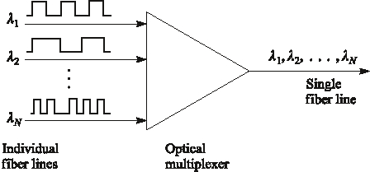
Wavelength Division Multiplexing
Each wavelength is like a separate channel (Fiber)
Notes:
6

Slide 5
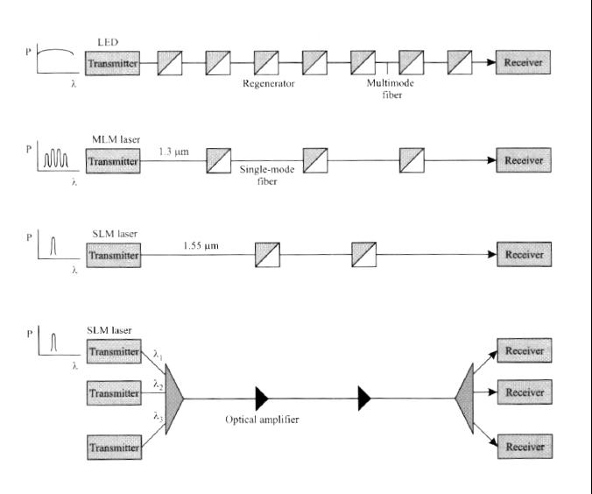
Evolution of the Technology

Slide 6
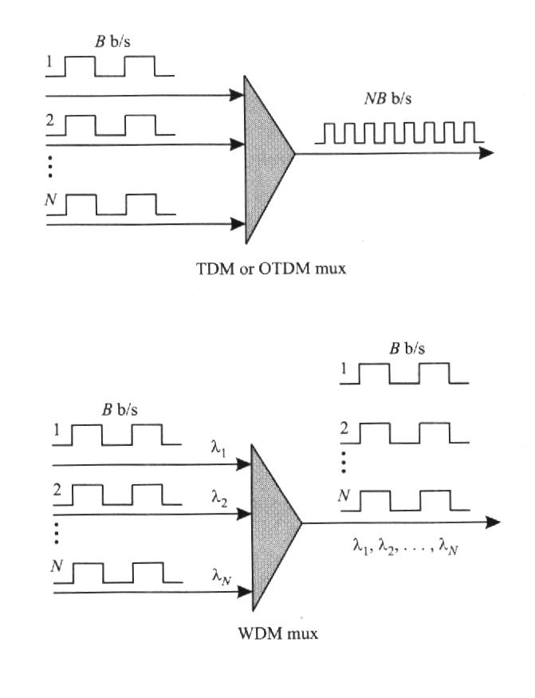
TDM Vs WDM
Ex: SONET

Slide 7
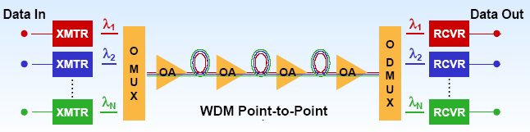
Wavelength Division Multiplexing
Passive/active devices are needed to combine, distribute, isolate and amplify optical power at different wavelengths.
Notes:
2

Slide 8
WDM, CWDM and DWDM
WDM technology uses multiple wavelengths to transmit information over a single fiber
Coarse WDM (CWDM) has wider channel spacing (20 nm) – low cost
Dense WDM (DWDM) has dense channel spacing (0.8 nm) which allows simultaneous transmission of 16+ wavelengths – high capacity

Slide 9
WDM and DWDM
First WDM networks used just two wavelengths, 1310 nm and 1550 nm
Today's DWDM systems utilize 16, 32,64,128 or more wavelengths in the 1550 nm window
Each of these wavelength provide an independent channel (Ex: each may transmit 10 Gb/s digital or SCMA analog)
The range of standardized channel grids includes 50, 100, 200 and 1000 GHz spacing
Wavelength spacing practically depends on:
  laser linewidth
  optical filter bandwidth

Slide 10
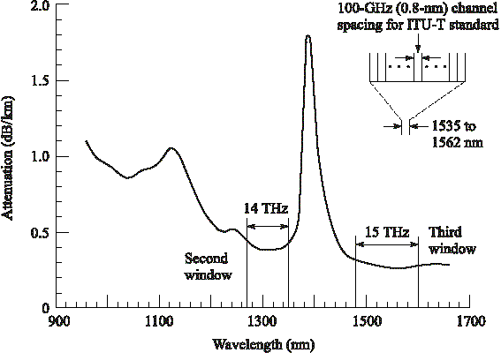
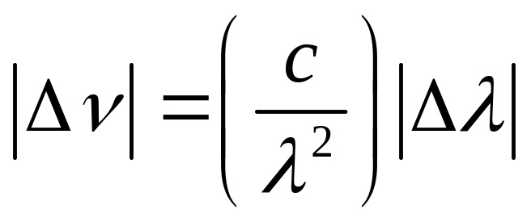
ITU-T Standard Transmission DWDM windows
Notes:
1

Slide 11
Principles of DWDM
BW of a modulated laser: 10-50 MHz → 0.001 nm
Typical Guard band: 0.4 – 1.6 nm
80 nm or 14 THz @1300 nm band
120 nm or 15 THz @ 1550 nm
Discrete wavelengths form individual channels that can be modulated, routed and switched individually
These operations require variety of passive and active devices
Ex. 10.1

Slide 12
Nortel OPTERA 640 System
64 wavelengths each carrying 10 Gb/s

Slide 13
DWDM Limitations
Theoretically large number of channels can be packed in a fiber
For physical realization of DWDM networks we need precise wavelength selective devices
Optical amplifiers are imperative to provide long transmission distances without repeaters

Slide 14
Part II: WDM Devices

Slide 15
Key Components for WDM
Passive Optical Components
  Wavelength Selective Splitters
  Wavelength Selective Couplers
Active Optical Components
  Tunable Optical Filter
  Tunable Source
  Optical amplifier
  Add-drop Multiplexer and De-multiplexer

Slide 16
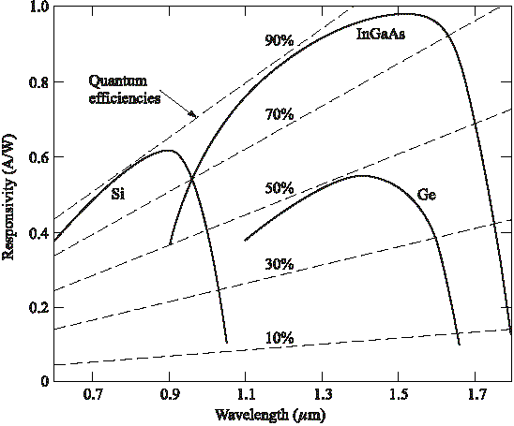
Photo Detector Responsivity
Photo detectors are sensitive over wide spectrum (600 nm).
Hence, narrow optical filters needed to separate channels before the detection in DWDM systems

Slide 17
Passive Devices
These operate completely in the optical domain (no O/E conversion) and does not need electrical power
Split/combine light stream Ex: N X N couplers, power splitters, power taps and star couplers
Technologies: - Fiber based or
  Optical waveguides based
  Micro (Nano) optics based
Fabricated using optical fiber or waveguide (with special material like InP, LiNbO₃)

Slide 18
Passive Components
Coupler: versatile device used as a building block for several other optical devices
Isolator: used in systems at the output of amplifiers and lasers to prevent reflections
Filter: to multiplex and demultiplex wavelengths in a WDM system, and to provide equalization of the gain and filtering of noise in optical amplifier
MUX & DEMUX: MUX combines signals at different wavelengths on its input ports onto a common output port, DEMUX performs the opposite function

Slide 19
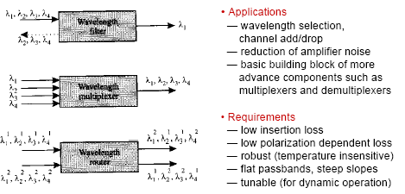
Filter, Multiplexer and Router

Slide 20
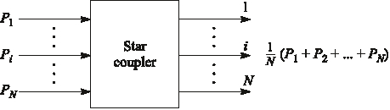
Basic Star Coupler
May have N inputs and M outputs
Can be wavelength selective/nonselective
Up to N =M = 64, typically N, M < 10
Notes:
3

Slide 21
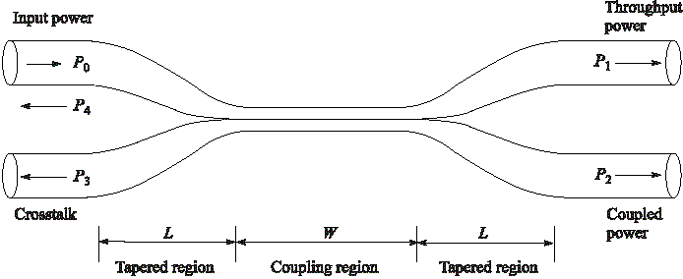
Fused-Biconical Coupler or
Directional Coupler
P3, P4 extremely low ( -70 dB below Po)
Coupling / Splitting Ratio = P2/(P1+P2)
If P₁=P₂ → It is called 3-dB coupler
Notes:
4

Slide 22
Coupler
Fabricated by twisting together, melting and pulling together two single mode fibers
They get fused together over length W; tapered section of length L; total draw length = L+W
Significant decrease in V-number in the coupling region; energy in the core leak out and gradually couples into the second fibre

Slide 23
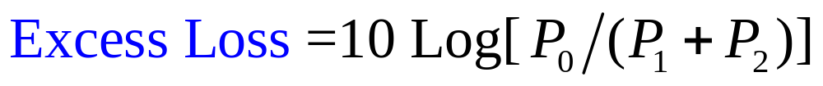
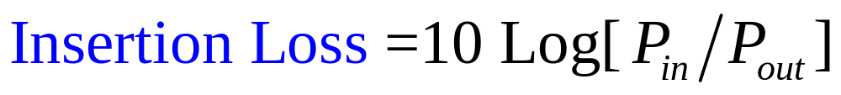
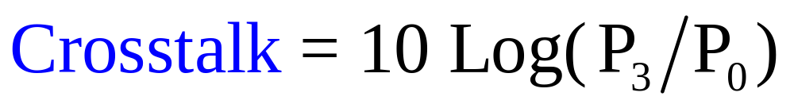
Definitions

Slide 24
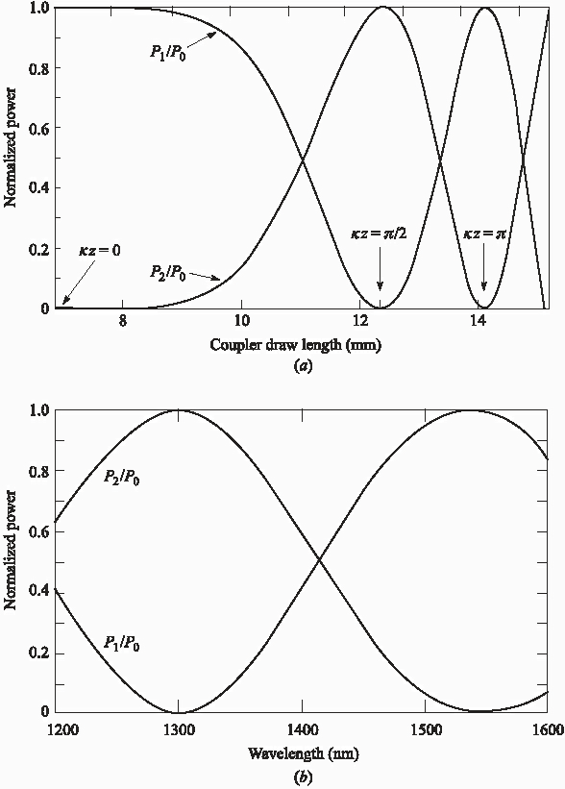


Coupler Characteristics
κ: Coupling Coefficient
Notes:
5

Slide 25
Coupler Characteristics
  power ratio between both output can be changed by adjusting the draw length of a simple fused fiber coupler
  It can be made a WDM de-multiplexer:
    Example, 1300 nm will appear output 2 (p2) and 1550 nm will appear at output 1 (P1)
    However, suitable only for few wavelengths that are far apart, not good for DWDM

Slide 26
Wavelength Selective Devices
These perform their operation on the incoming optical signal as a function of the wavelength
Examples:
Wavelength add/drop multiplexers
Wavelength selective optical combiners/splitters
Wavelength selective switches and routers

Slide 27
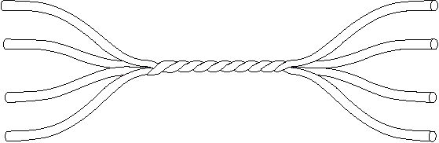
Fused-Fiber Star Coupler
Splitting Loss = -10 Log(1/N) dB = 10 Log (N) dB
Excess Loss = 10 Log (Total P_{in}/Total P_{out})
Fused couplers have high excess loss
Notes:
11

Slide 28
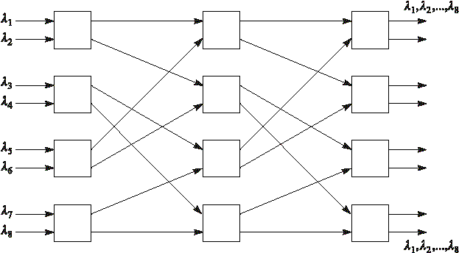
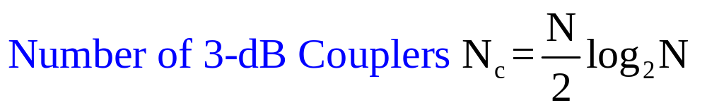
8x8 Bi-directional Star Coupler by Cascading 3-stages of 3-dB Couplers
λ₁, λ₂
λ₁, λ₂ λ₅, λ₆
λ₁, λ₂
λ₃, λ₄ λ₇, λ₈
(12 = 4 X 3)
Try Ex. 10.5
Notes:
12

Slide 29
Passive Non-Reciprocal Devices
Types
  Isolators
  Faraday Rotators
  Circulators

Slide 30
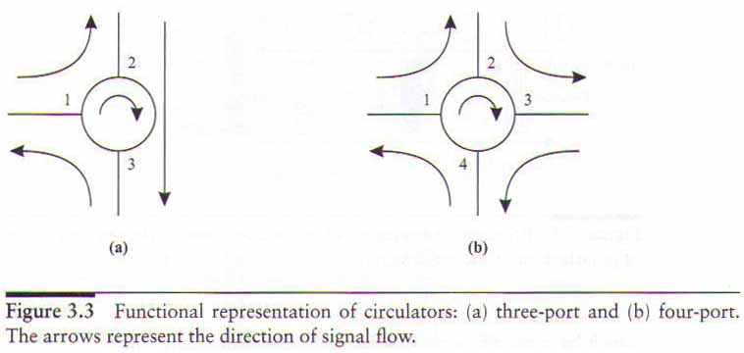
Isolators and Circulators
(Nonreciprocal devices)
Isolators are for transmitter, circulators are for add and drop or others.
The insertion loss should be small ~ 1dB
A circulator is similar to an isolator except it has multiple ports.

Slide 31
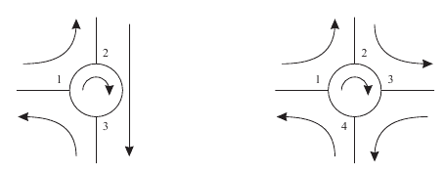
Isolators
Transmit in one direction only
Avoid reflection of laser – or any reflection
One input, one output or multiple ports
Key parameters are insertion loss and excess loss
Example of circulators:

Slide 32
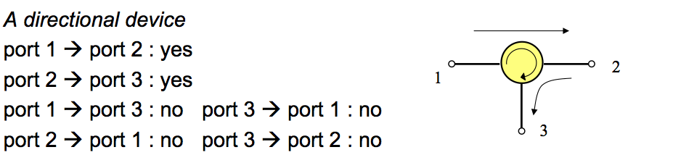
Isolators - Passive Non-Reciprocal Device
Transmit in one direction only
Avoid reflection of laser – or any reflection
One input, one output or multiple ports
Key parameters are insertion loss and excess loss
Example: circulator

Slide 33
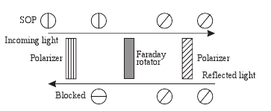
Operation of Isolators
Only Ex exists
State of polarization is fixed (SOP)
Rotator rotates by 45 degree

Slide 34
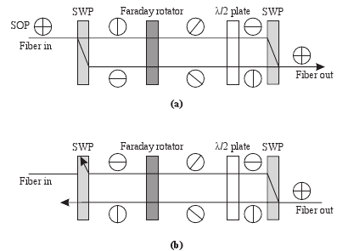
Operation of Isolators – more realistic
Polarization Independent Isolator
Half-wavelength plates are used to rotate 45 degree
The Spatial-walk-off polarizer splits the signal into two orthogonally polarized signals

Slide 35
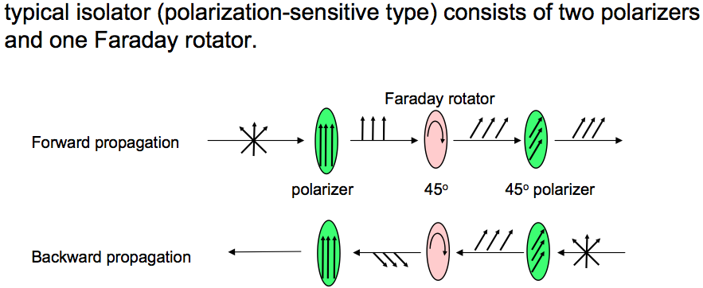
Operation of Isolators

Slide 36
Interferometers

Slide 37
Interferometer
An interferometric device uses 2 interfering paths of different lengths to resolve wavelengths
Typical configuration: two 3-dB directional couplers connected with 2 paths having different lengths
Applications:
— wideband filters (coarse WDM) that separate signals at1300 nm from those at 1550 nm
— narrowband filters: filter bandwidth depends on the number of cascades (i.e. the number of 3-dB couplers connected)

Slide 38
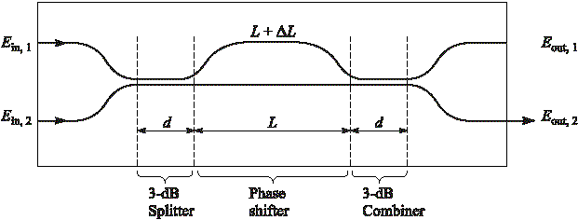
Basic Mach-Zehnder Interferometer
Phase shift of the propagating wave increases with ΔL,
Constructive or destructive interference depending on ΔL

Slide 39
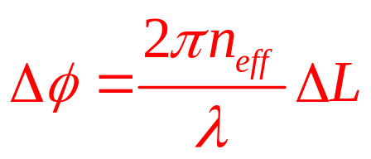
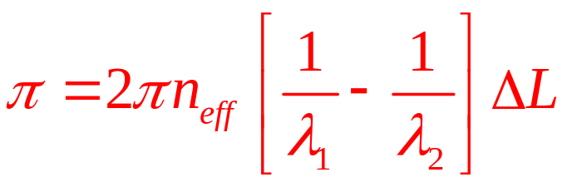
Mach-Zehnder Interferometer
Phase shift at the output due to the propagation path length difference:
If the power from both inputs (at different wavelengths) to be added at output port 2, then,

Slide 40
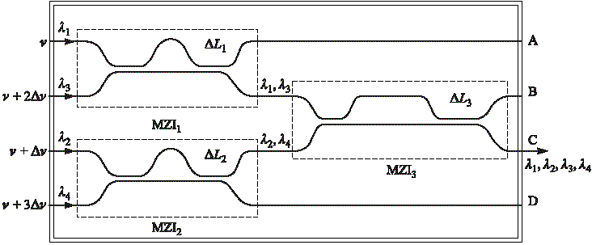
Four-Channel Wavelength Multiplexer
By appropriately selecting ΔL, wavelength multiplexing/de-multiplexing can be achieved

Slide 41
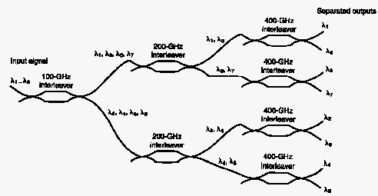
MZI- Demux Example

Slide 42
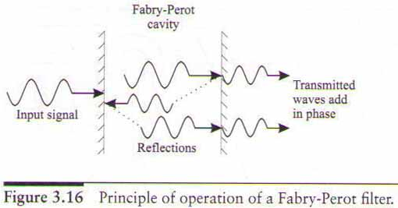
Fabry-Perot Filters
This filter is called Fabry-Perot interferometer or etalon.
Principle of Operation
The wavelengths for which the cavity length is an integral multiple of half the wavelength in the cavity are called resonant wavelengths.

